Slide 1
Battery Pack – Pam Crash
06.02.2025

Slide 2
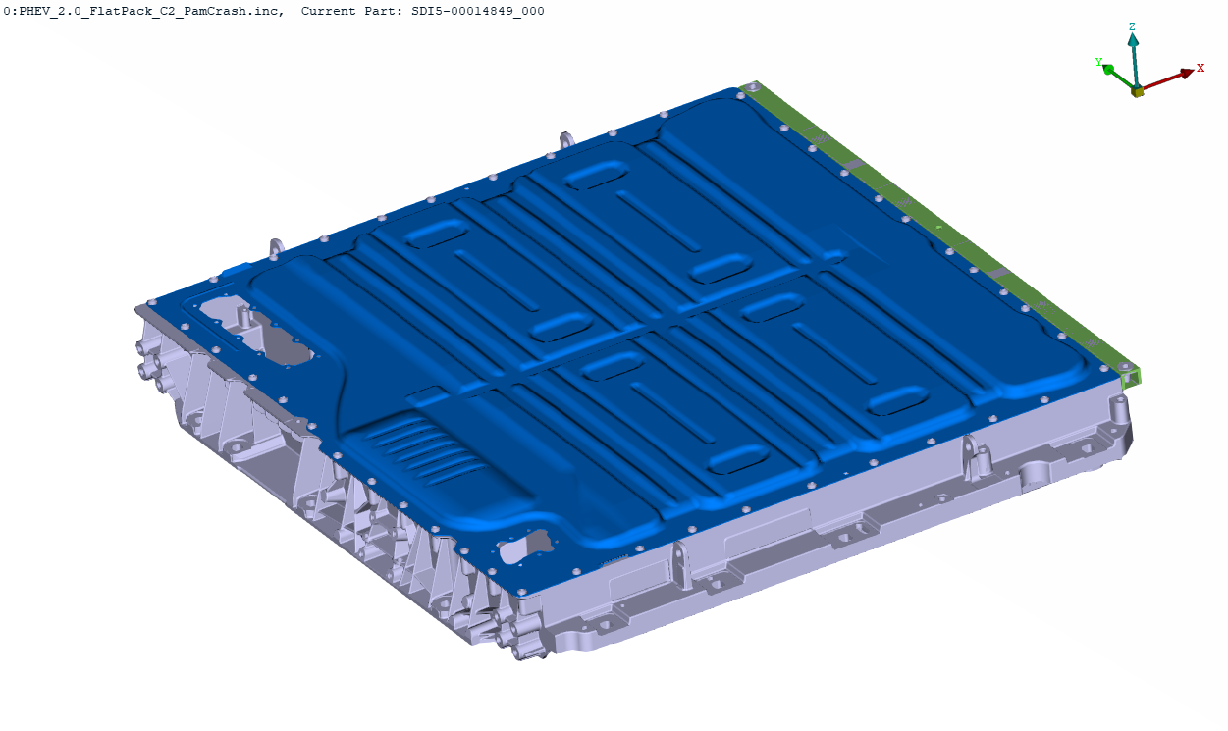
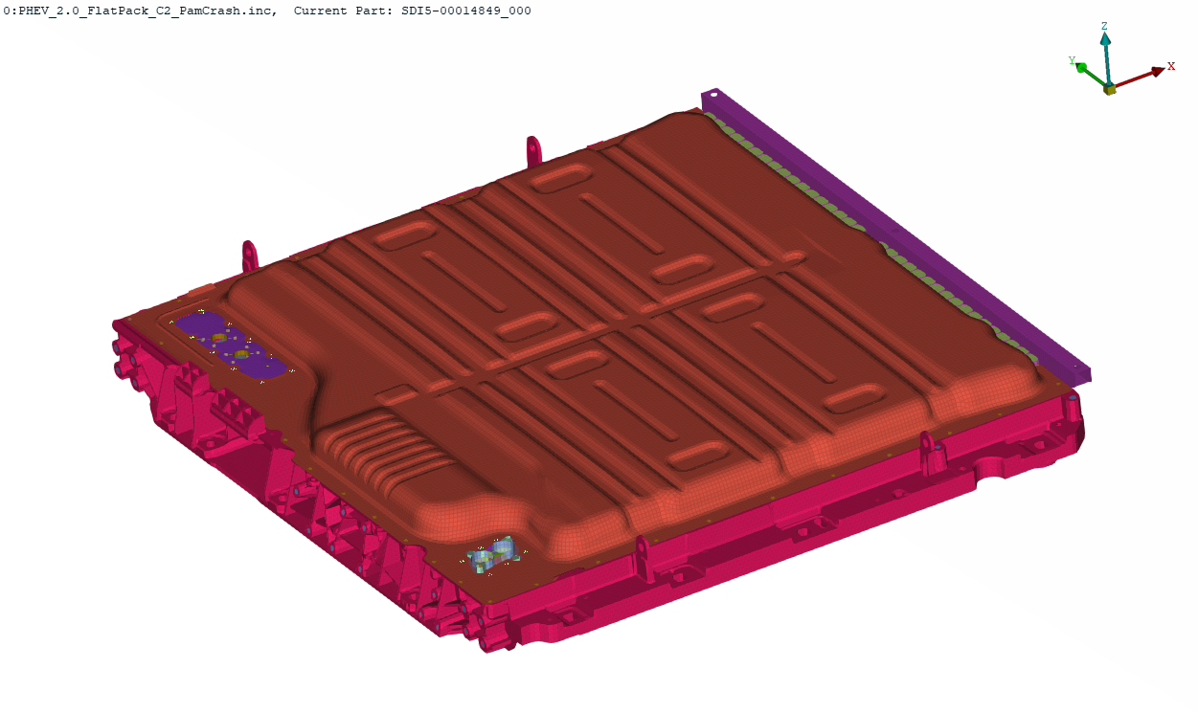
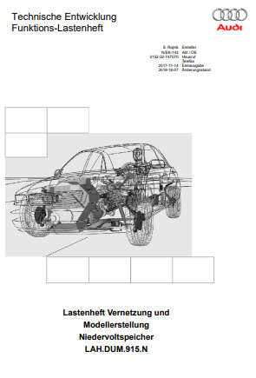
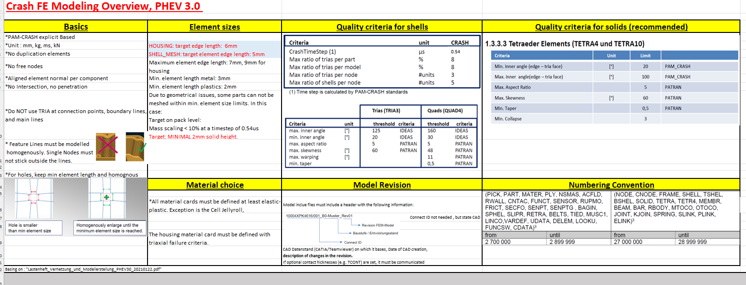
Inputs, 06.02.2025
CAD
FEM - Example
Guideline
PHEV_2.0_FlatPack_C2_PamCrash
SDI5-00034471-000.003-E068_NTP_DATA FOR CRASH SIMULATION

Slide 3
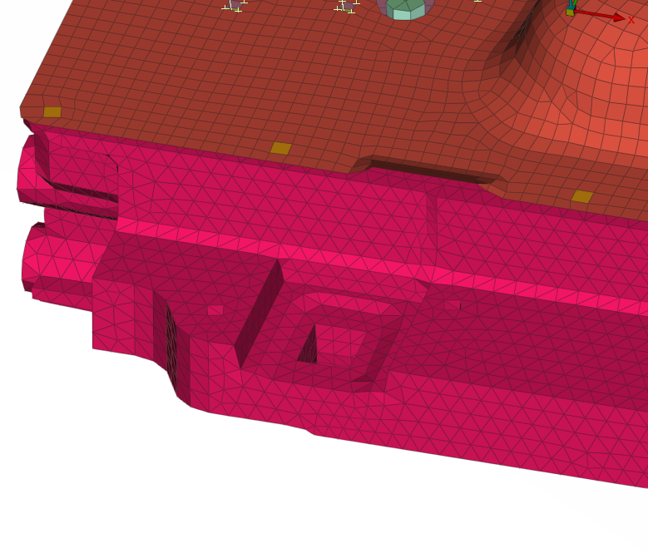
MESHING
Shells:
Target Element length = 5mm
HOUSING:
Target Element length = 6mm

Slide 4
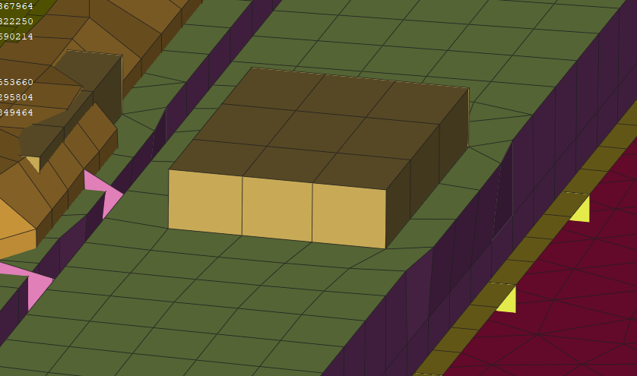
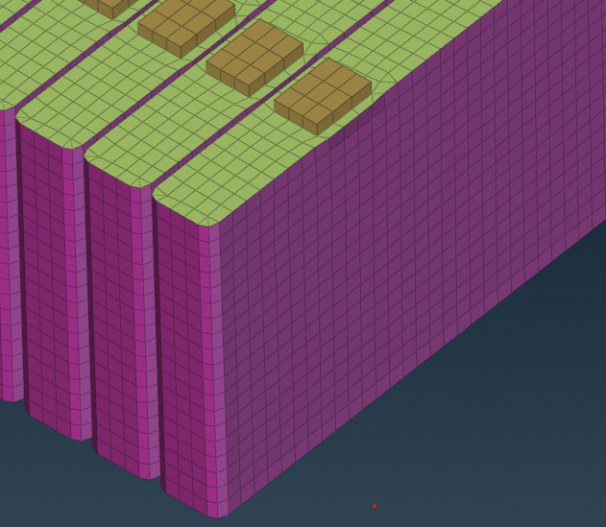
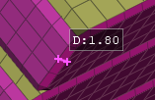
MESHING: cells
To move the nodes of the cell to fulfil quality criteria (min lenght=3min )
Cells will be re-positioned,
Re-meshed in bottom area

Slide 5
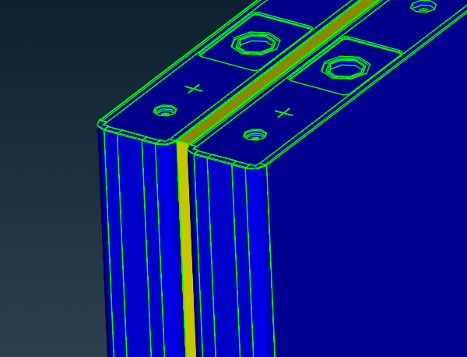
MESHING: cells
Spacer:
Data for a material card will be delivered.
Hexa Solid 1 layer

Slide 6
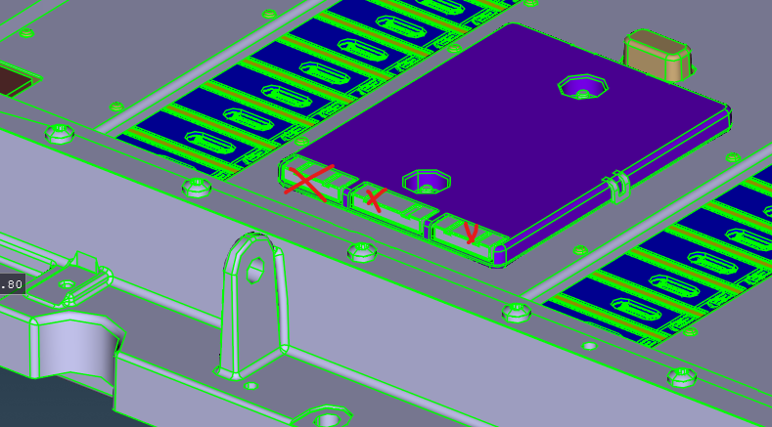
MESHING: cells
Will not be meshed

Slide 7
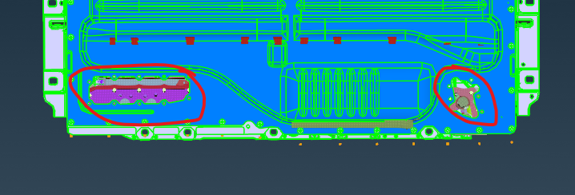
MESHING: cells
Components from the example, position TBD

Slide 8
MESHING:
Same as in the example model
PID definition
SET definition
MID
Contacts
Numbering range

Slide 9
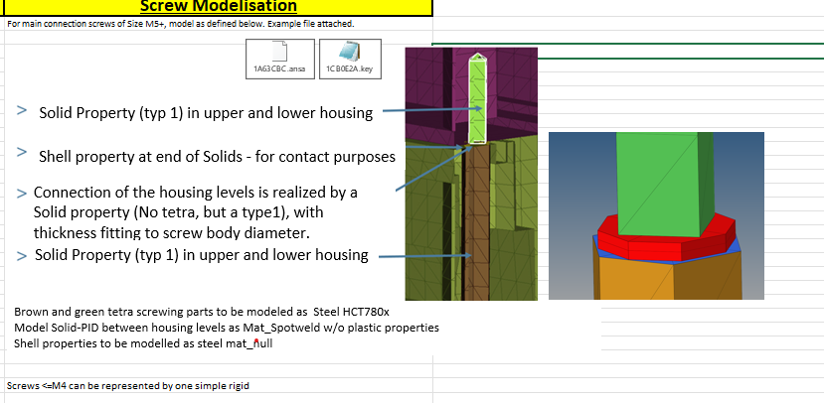
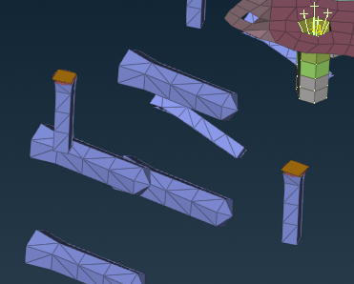
Bolts - Housing
d< 5mm – Beams spiders
d≤ 5mm – SOILDS

Slide 10
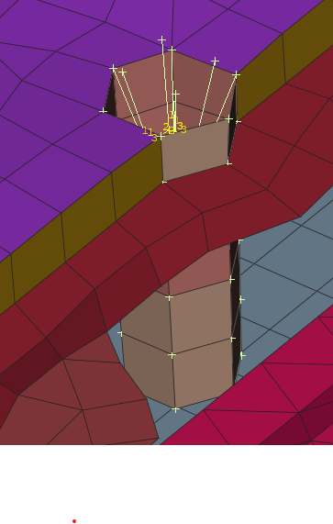
Bolts – in general
Beams spiders

Slide 11
Mass
Information regarding mass distribution is needed

Slide 12
Delivery
Final FE-Model
Deadline 12th of Feb. 2025 EOB

