Slide 1
Battery Pack E71
07-Apr-2025

Slide 2
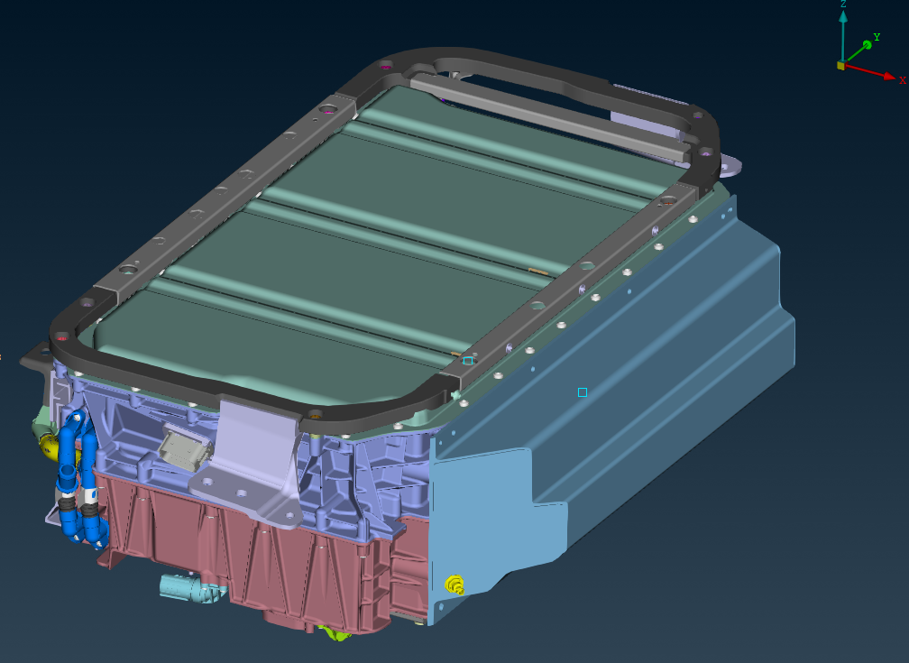
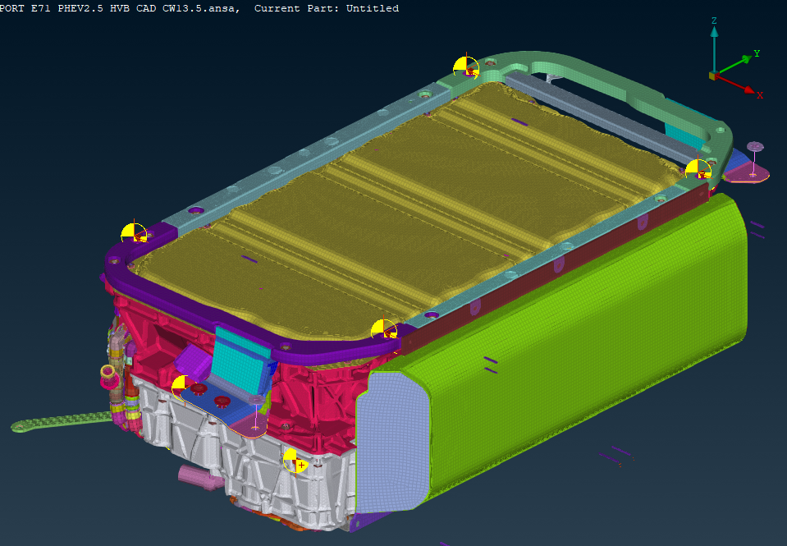
Inputs
CAD
FEM - Example
FEM - High pack
SDI5-00035091-000.007-EXPORT E71 PHEV2.5 HVB CAD CW13.5.stp
270-PO63__-S1-hv_module______-_-___-__-_____-__-______-_-HV_BM-011-c7344d06___wo_cuves.key

Slide 3
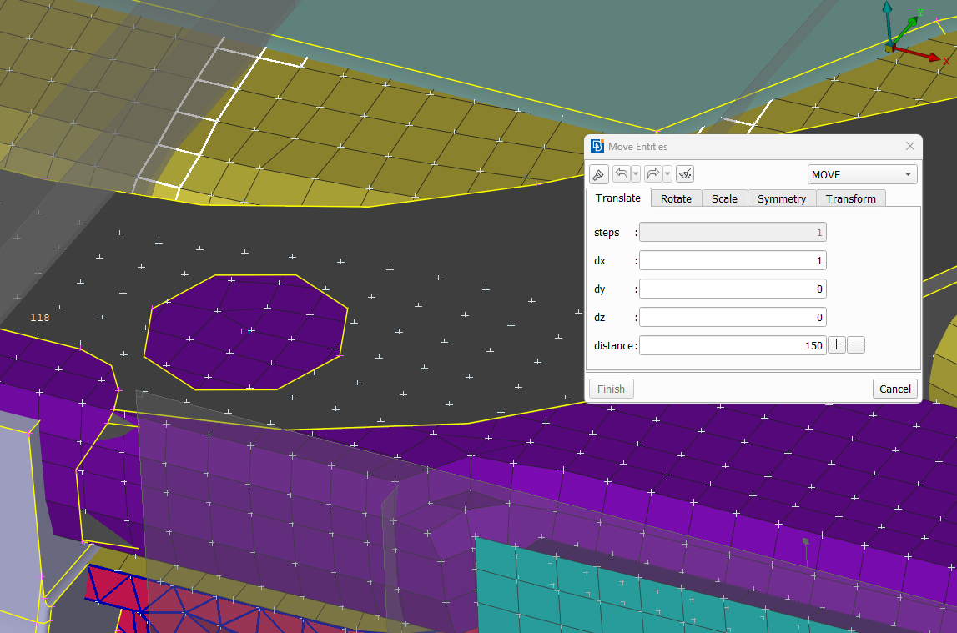
Position
CAD
Use CAD position of the BP,
Move FE-Model by -150mm in X

Slide 4
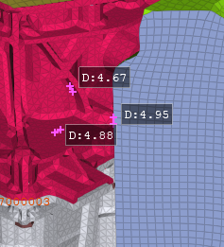
MESHING
Shells:
Target Element length = 5mm
HOUSING:
Target Element length = 6mm
(The example model was 5.0 mm)

Slide 5
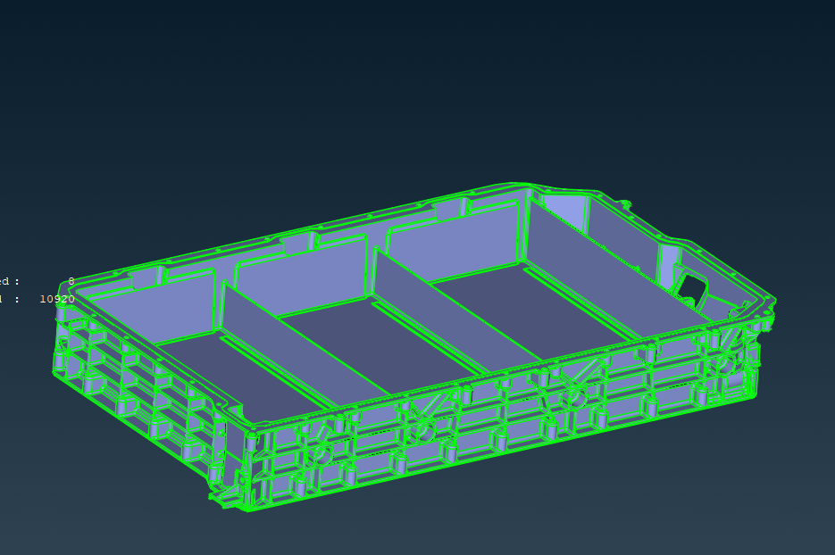
MESHING
HOUSING:
3 ribs inside with Element length = 8mm
Shells:
Target Element length = 5mm
HOUSING:
Target Element length = 6mm
(The example model was 5.0 mm)

Slide 6
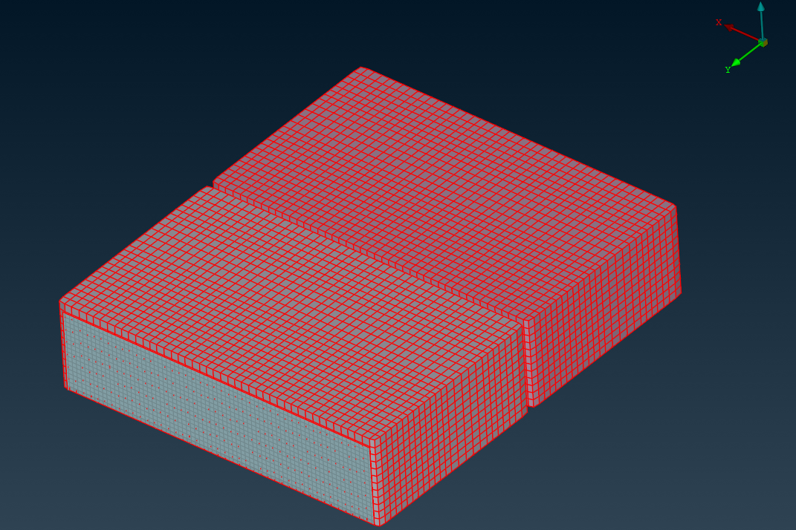
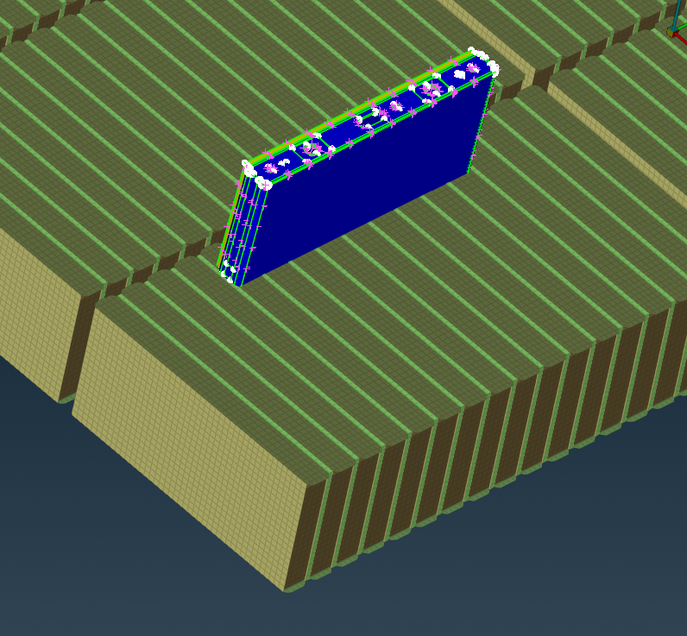
MESHING: cells
Cells in the example – One block
The Cells with spacers shall be taken from High Pack
To be shared

Slide 7
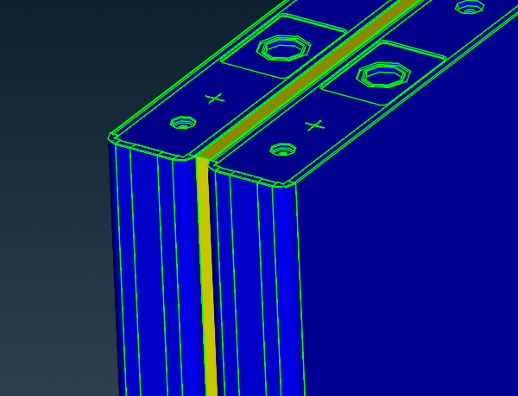
MESHING: Spacer
The MID for the spacer from High Pack

Slide 8
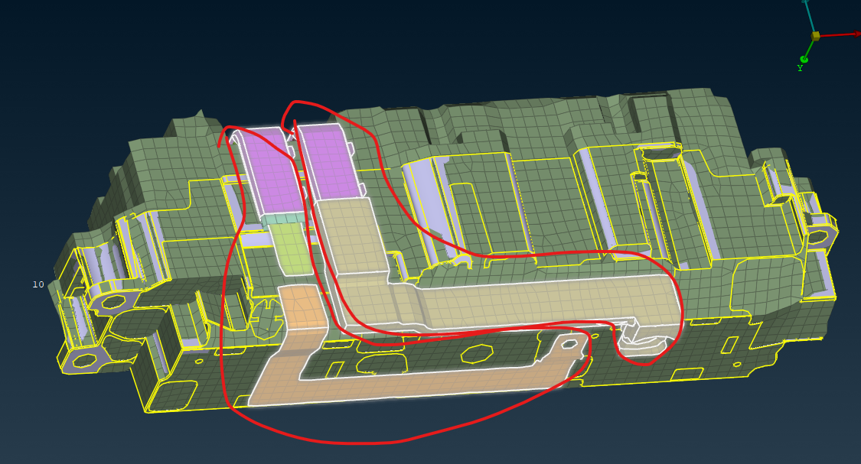
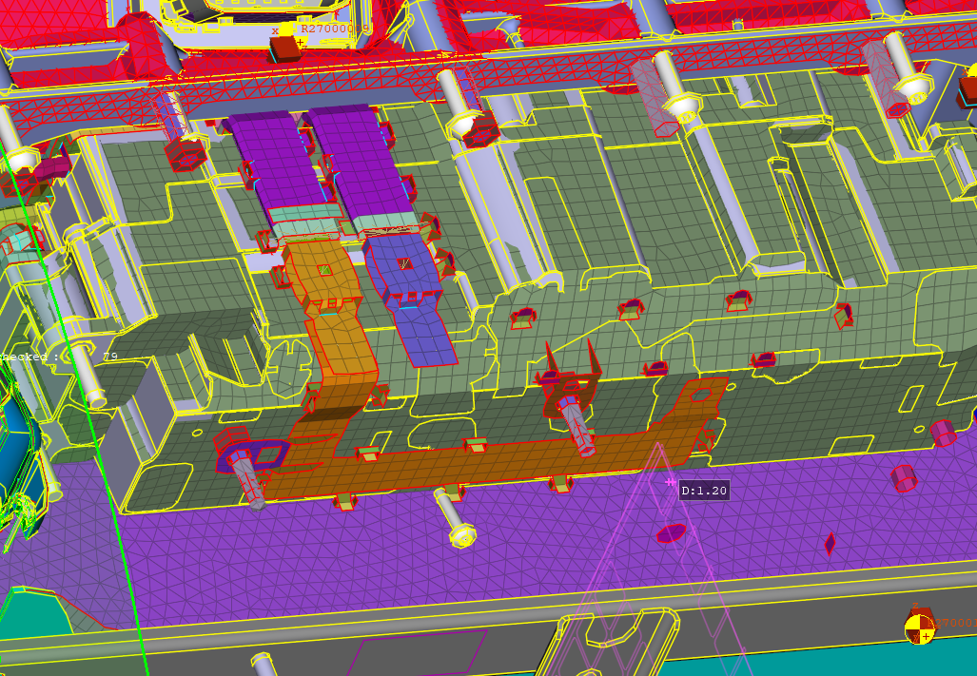
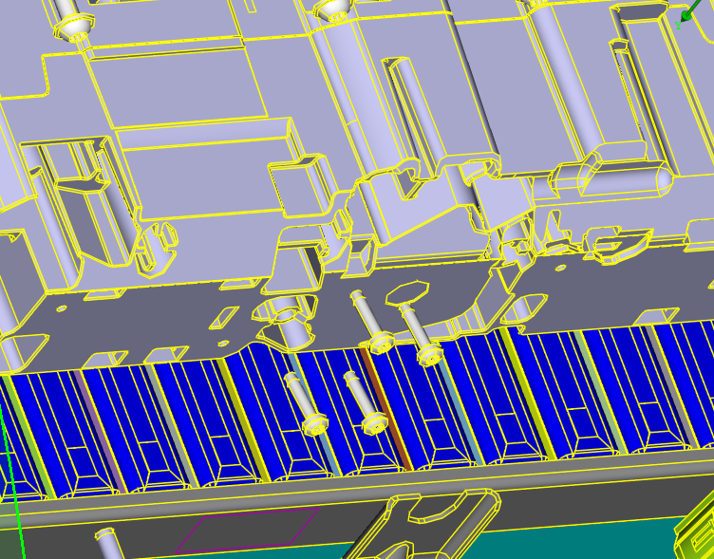
MESHING: wiring
No CAD for the wires and its plastic covers available! Do not include in the new FE-Model.

Slide 9
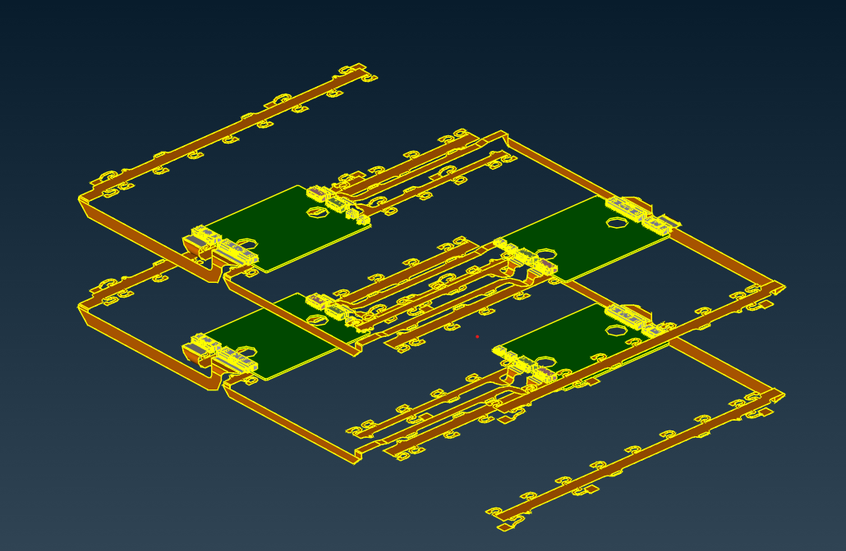
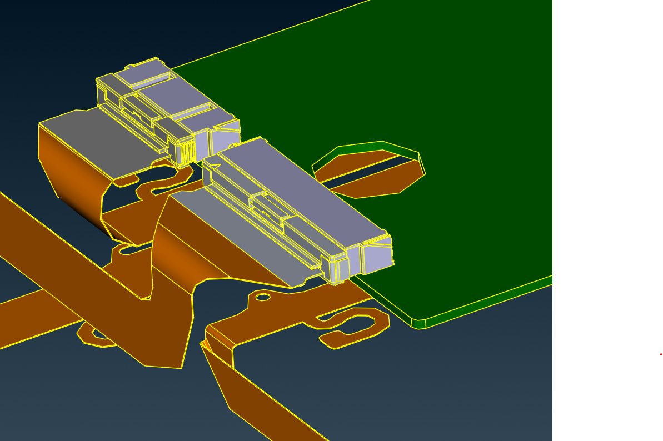
MESHING: electronics
Will not be meshed

Slide 10
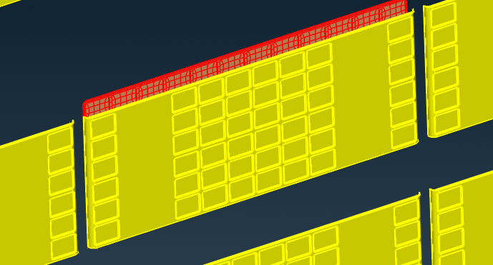
MESHING: END BLOCK
END_BLOCK_SOL
As Hexa mesh (not as Shells as in PAM-CRASH models)

Slide 11
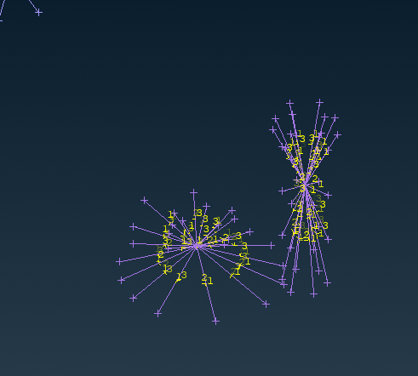
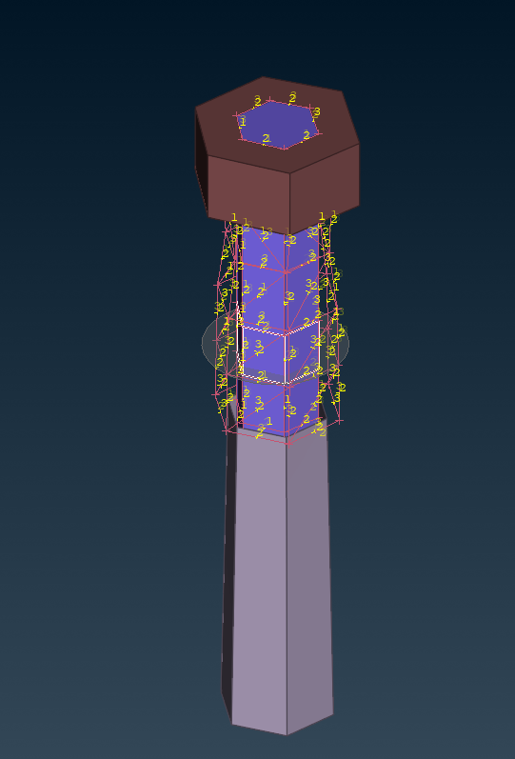
Bolts - Housing
1. Beams spiders
2. Bolts with pre-tension

Slide 12
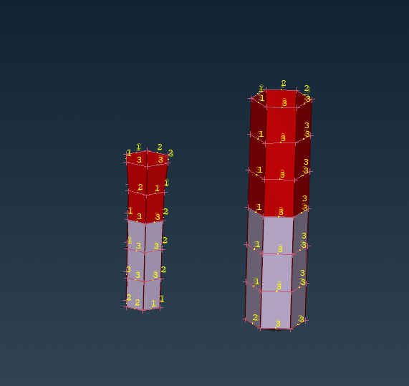
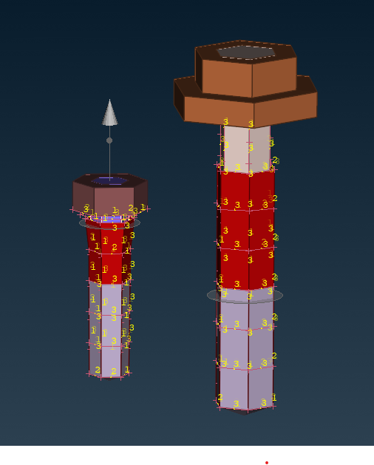
Bolts - Housing
Take the bolts and holes(in the housing) from the example
1. Create skin-shells on the housing
2. Use the skin-shells by housing meshing → due to matching to the solid bolts

Slide 13
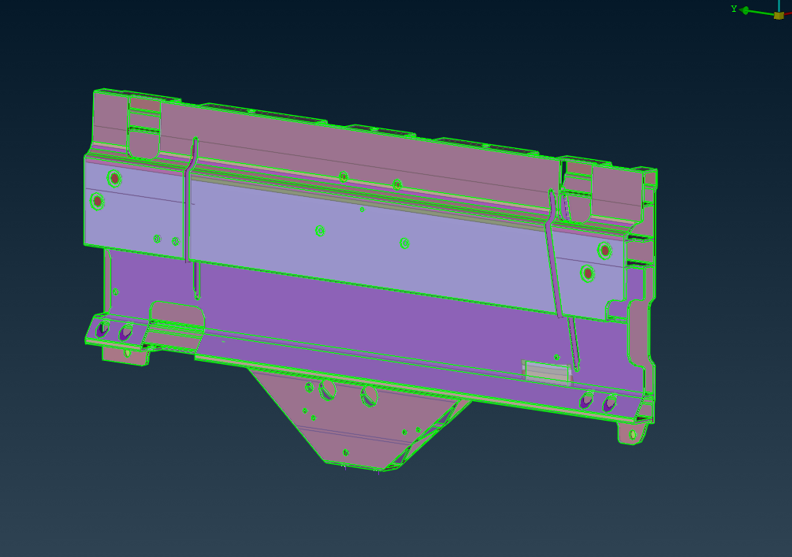
front structure
To be taken from example

Slide 14
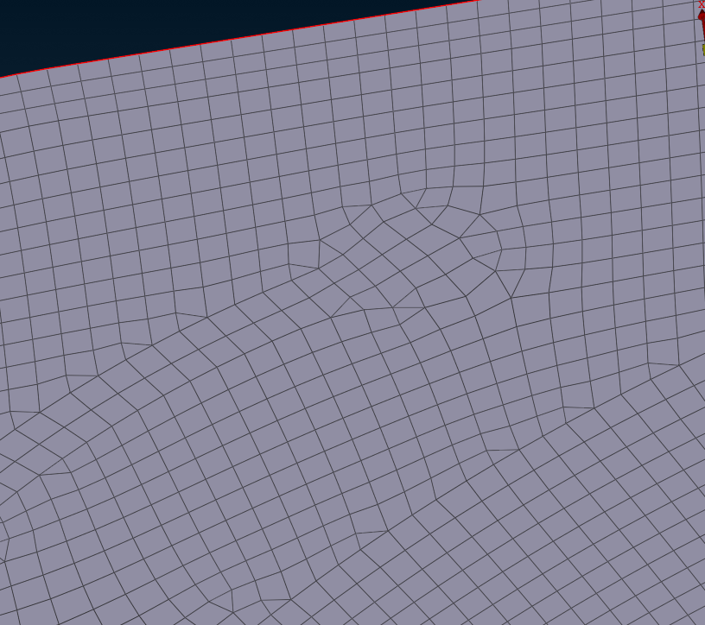
front structure
Bottom cover → perimeters no needed

Slide 15
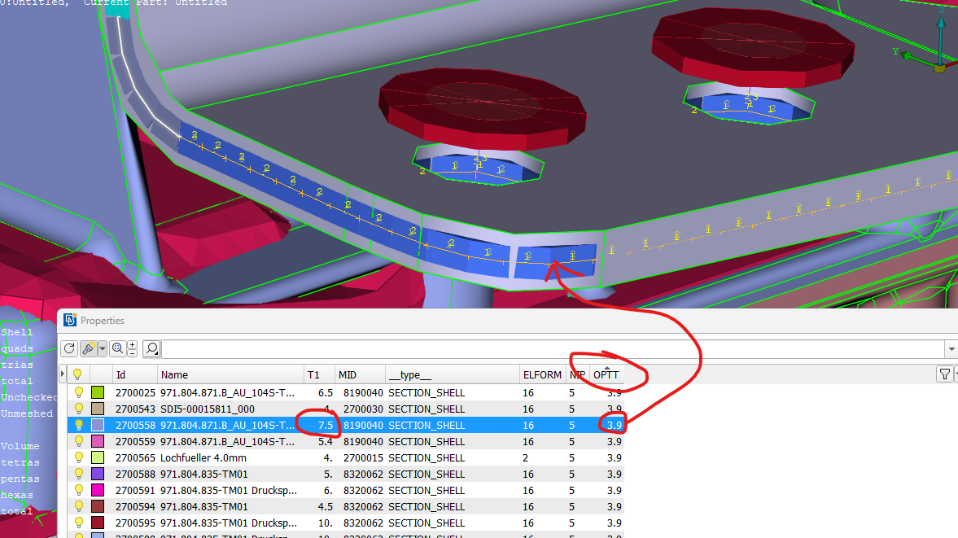
front structure
OPTT is used

Slide 16
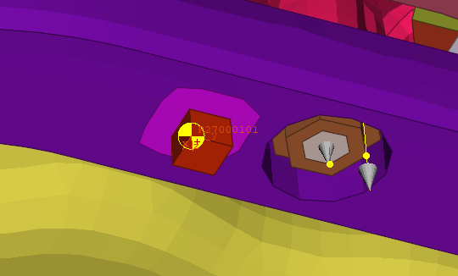
Sensors
Take the ACC sensors from the example

Slide 17
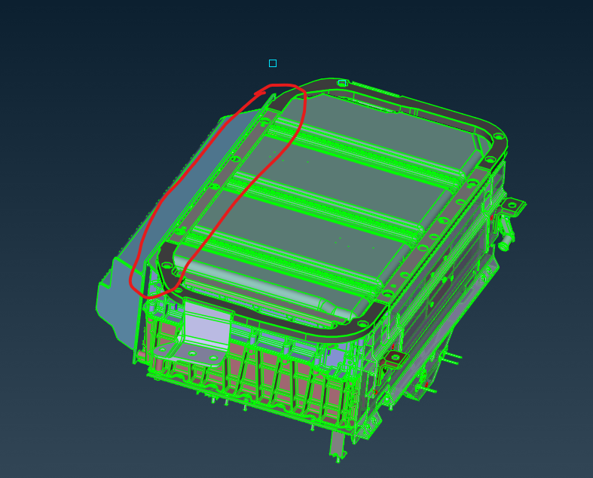
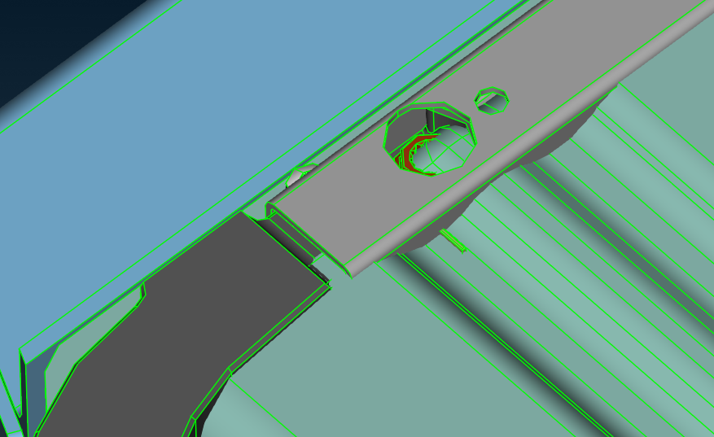
INTERSECTIONS in CAD
Information will follow

Slide 18
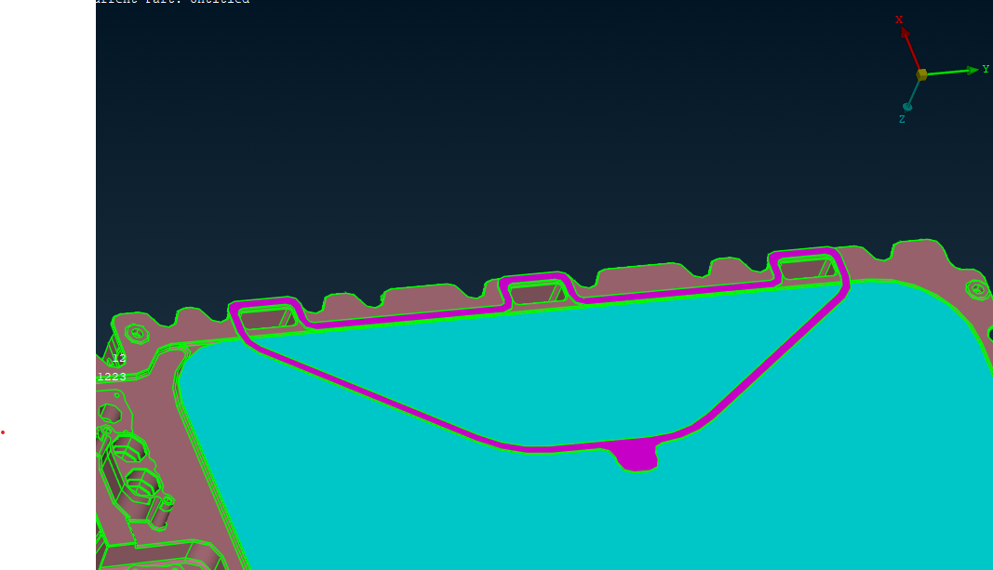
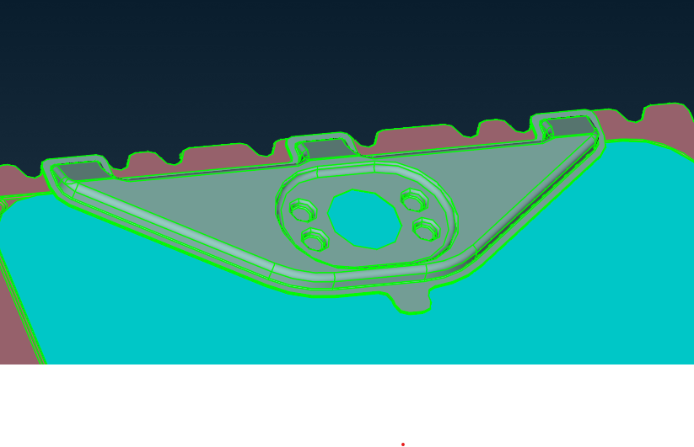
INTERSECTIONS in CAD
Do not mesh the sealing → the cover will be connected by TIED

Slide 19
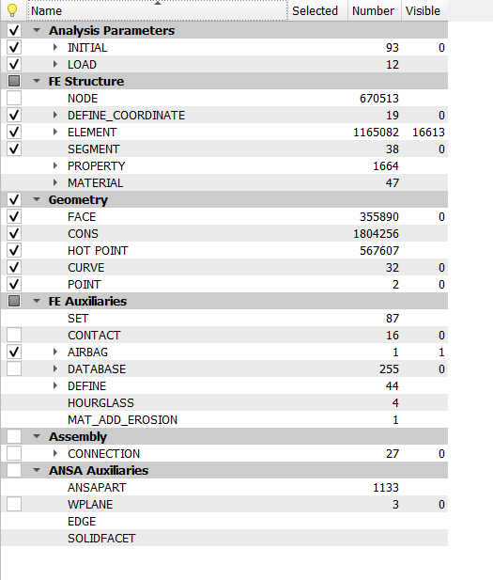
INTERSECTIONS in CAD

Slide 20
Delivery
FE-Model
Deadline: 20.04.2025

